Slide 1


Special topics
Session 10
Al-Zahra university
Maryam zim
@maryamzim maryamxiim@gmail.com

Slide 2
Array methods:
2. Accessor Methods (Non-Mutating)
These methods retrieve data from the array without changing the original array.
Like :
Concat() : The concat() method concatenates (joins) two or more arrays and returns a new array, containing the joined arrays. The concat() method does not change the existing arrays.
join(): The join() method returns an array as a string AND does not change the original array. Any separator can be specified. The default is comma (,).
Slice() : The slice() method returns selected elements in a new array.
The slice() method selects from a given start, up to a (not inclusive) given end. The slice() method does not change the original array.

Slide 3
Method | Description | Example
.slice(start, end) | Returns a new array containing a shallow copy of a portion of the original array specified by start and end indices. | arr.slice(1, 3) => copies elements from index 1 up to (but not including) index 3
.concat(arr1, arr2, ...) | Returns a new array that is the combination of the original array and the arrays/values passed as arguments. | arr1.concat(arr2)
.join(separator) | Creates and returns a new string by concatenating all of the elements in an array. | arr.join('-’) => "a-b-c"

Slide 4

Array methods:
3. Search and Test Methods
These methods are used to find elements or check if elements meet certain criteria. They typically do not mutate the array.
Like :
IndexOf(): The indexOf() method returns the position of the first occurrence of a value in a string and returns -1 if the value is not found. The indexOf() method is case sensitive.
Find(): The find() method returns the value of the first element that passes a test and executes a function for each array element. The find() method returns undefined if no elements are found. The find() method does not execute the function for empty elements and does not change the original array.
Includes(): The includes() method returns true if an array contains a specified value. The includes() method returns false if the value is not found. The includes() method is case sensitive.

Slide 5
Method | Description | Example
.indexOf(searchElement, fromIndex) | Returns the first index at which a given element can be found, or -1 if it is not present. | arr.indexOf('b’) => 1
.includes(searchElement) | Returns a Boolean (true or false) indicating whether an array includes a certain value. | arr.includes('b’) = > true
.find(callback) | Returns the value of the first element in the array that satisfies the provided testing function. | arr.find(user => user.id === 5)

Slide 6
Array methods:
4. Iteration and Transformation Methods
These methods often take a callback function as an argument and generally return a new array or value, leaving the original array unchanged.
Like :
foreach(): The forEach() method of Array that executes a provided function once for each array element.
map(): map() creates a new array from calling a function for every array element. map() does not execute the function for empty elements. map() does not change the original array.
filter(): The filter() method creates a new array filled with elements that pass a test provided by a function. The filter() method does not execute the function for empty elements. The filter() method does not change the original array.
Reduce(): The reduce() method executes a reducer function for array element. The reduce() method returns a single value: the function's accumulated result. The reduce() method does not execute the function for empty array elements. The reduce() method does not change the original array.

Slide 7
Method | Description | Example
.forEach(callback) | Executes a provided callback function once for each array element. Returns nothing (undefined). | arr.forEach(val => console.log(val))
.map(callback) | Creates a new array by applying the callback function to every element in the original array. | arr.map(val => val * 2) = > [2, 4, 6] from [1, 2, 3]
.filter(callback) | Creates a new array with all elements that pass the test implemented by the callback function. | arr.filter(val => val > 10) => [20, 30] from [5, 20, 30]
.reduce(callback, initialValue) | Executes a reducer function (callback) on each element of the array, resulting in a single output value (e.g., sum, product, single object). | arr.reduce((acc, val) => acc + val, 0) => sum of all elements

Slide 8
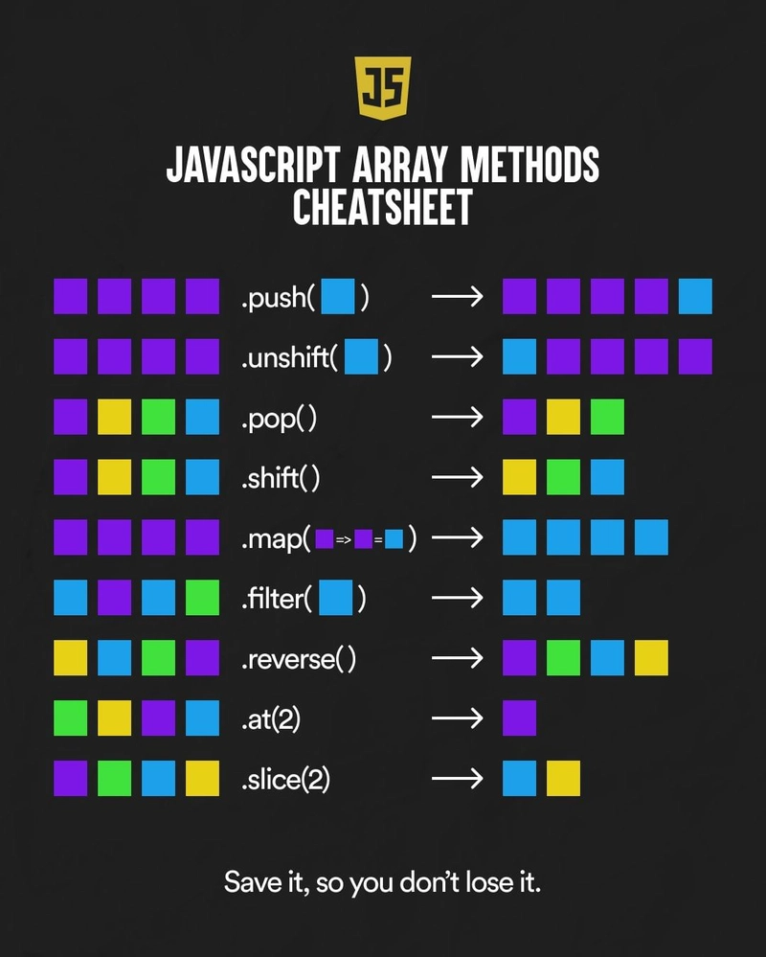
لطفا به متود .at توجه نکنید 🥲

Slide 9

Function:
Functions are reusable block of code designed to perform a particular task.
Functions are executed when they are "called" or "invoked".
JavaScript Function Syntax
Functions are defined with the function keyword:
followed by the function name
followed by parentheses ( )
followed by brackets { }
The function name follows the naming rules for variables.
Optional parameters are listed inside parentheses: ( p1, p2, ... ) Code to be executed is listed inside curly brackets: { } Functions can return an optional value back to the caller.

Slide 10
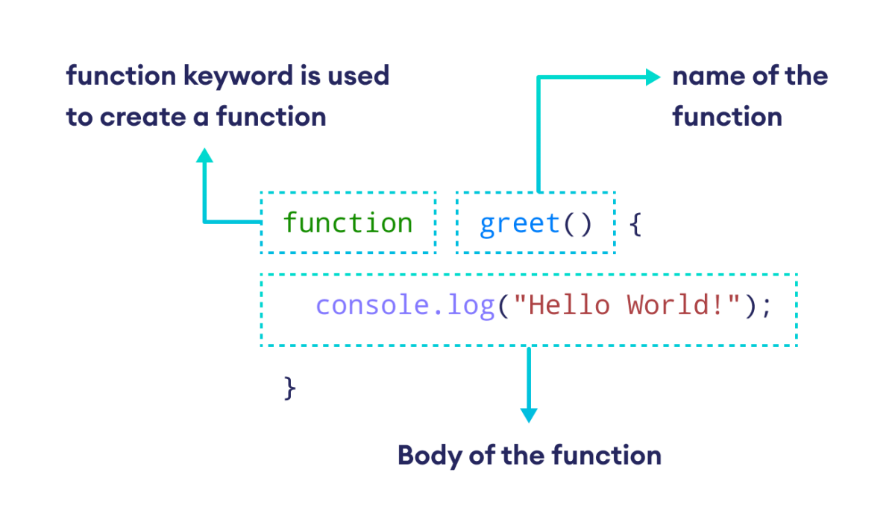
Function:
Functions are reusable block of code designed to perform a particular task.
Functions are executed when they are "called" or "invoked".
JavaScript Function Syntax
Functions are defined with the function keyword:
followed by the function name
followed by parentheses ( )
followed by brackets { }

Slide 11
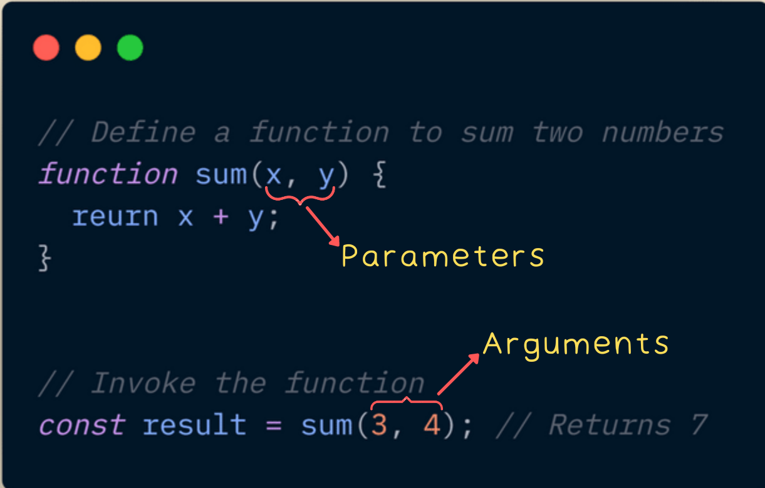
Function parameters and arguments:
Function parameters are the names listed in the function definition.
Function arguments are the real values passed to (and received by) the function.

Slide 12
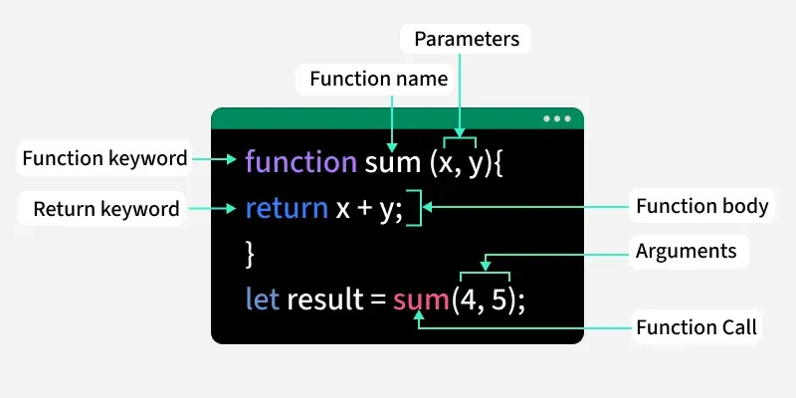
Return function:
The return statement stops the execution of a function and returns a value.
The value to be returned. If omitted, it returns undefined

Slide 13

Return function:
Arrow Functions were introduced in ES6.
Arrow Functions allow a shorter syntax for function expressions.
You can skip the function keyword, the return keyword, and the curly brackets:
Before Arrow:
With Arrow:

Slide 14

Callbacks:
"I will call back later!“
A callback is a function passed as an argument to another function
This technique allows a function to call another function
A callback function can run after another function has finished
این قسمت تو امتحان تون نمیاد صرفا جهت اطلاع بیشترتون هست

